Slide 1
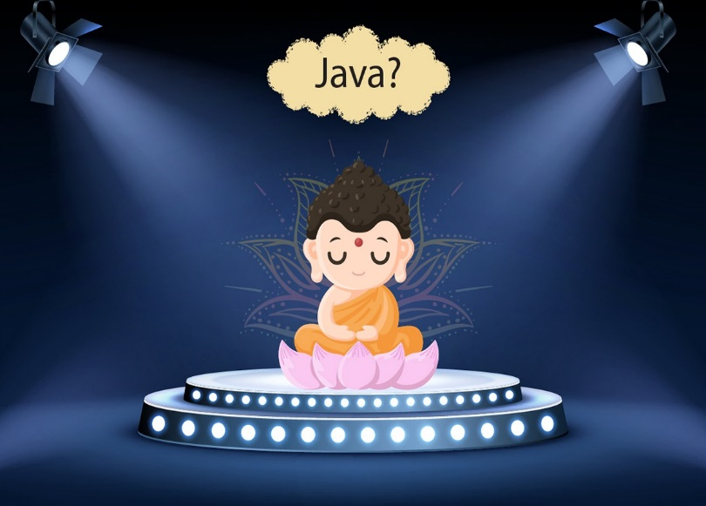
Topics to be covered today
How Java was born?
Understand applications & important features of Java
OOPS concept
Data Structures
cover array - 1Dimentional & 2Dimentional array concepts

Slide 2
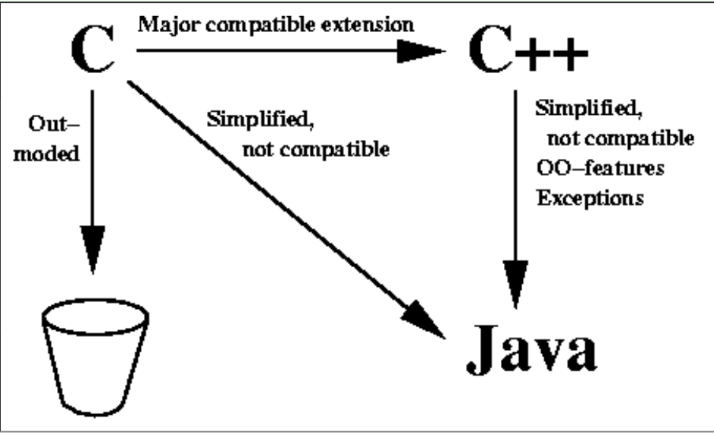
Why Java was born?
Platform independence
Garbage Collection

Slide 3
“Write once, work anywhere”

Slide 4
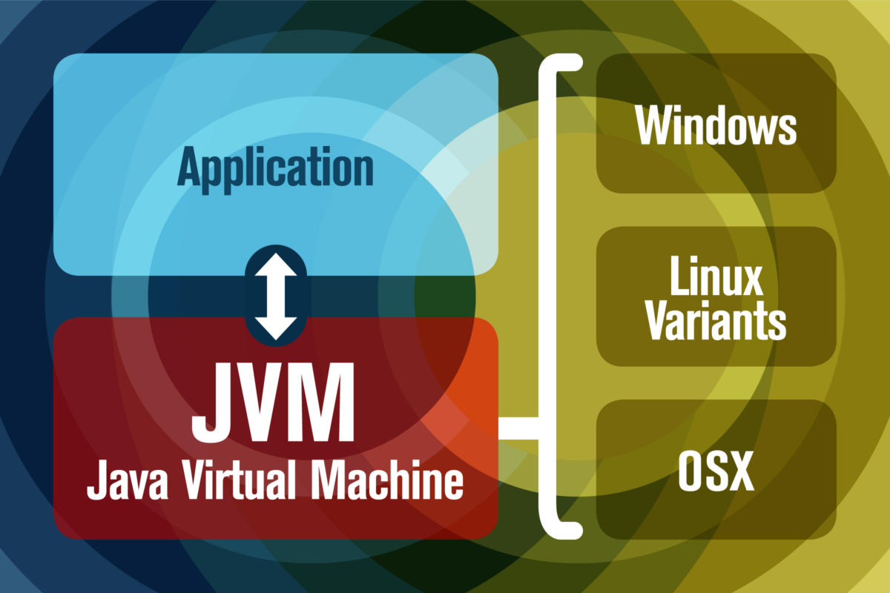
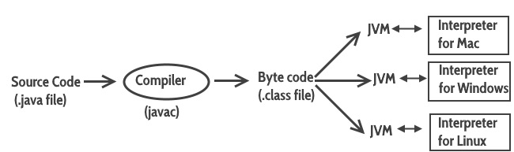
“No doubt Java is Platform Independent, but Java is JVM dependent “

Slide 5
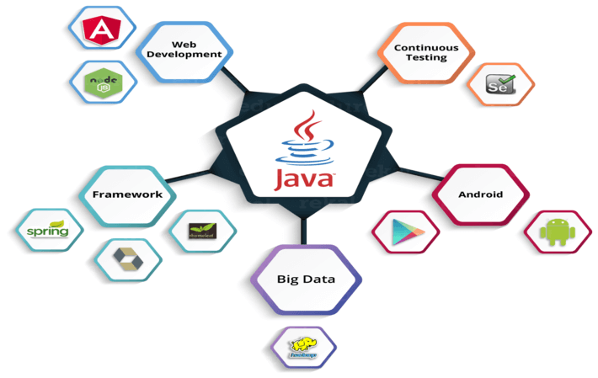

Slide 6
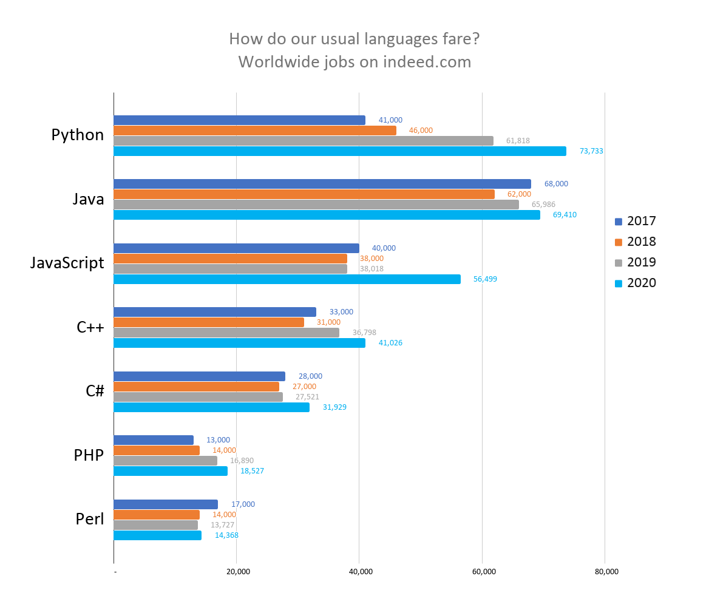

Slide 7
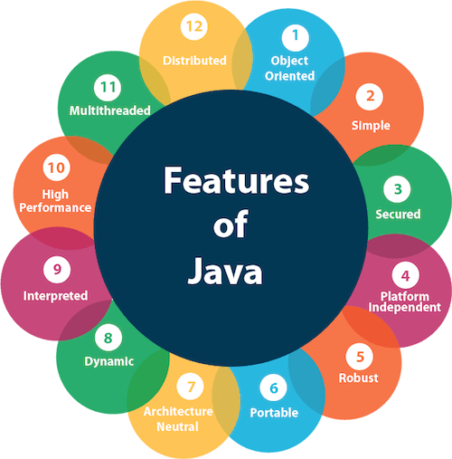

Slide 8
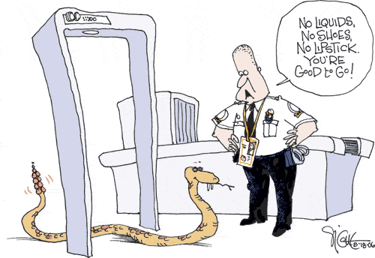
Security
Byte code concept
No Pointers
Exception Handling and many more.
Security APIs and SecurityManager Class
Restrict the Access

Slide 9
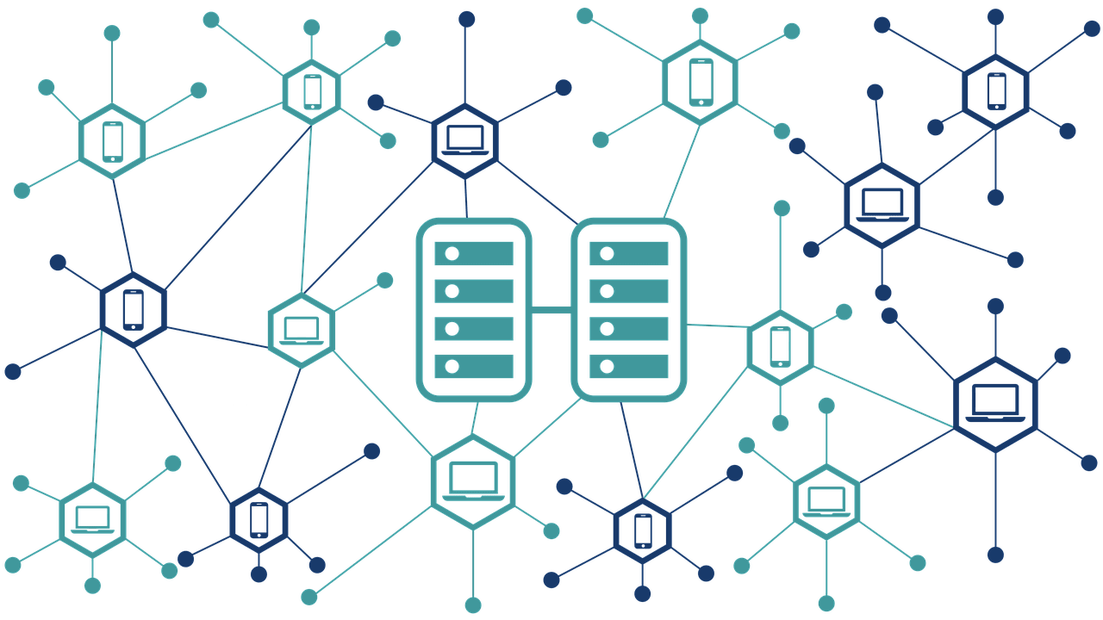
Distributed

Slide 10
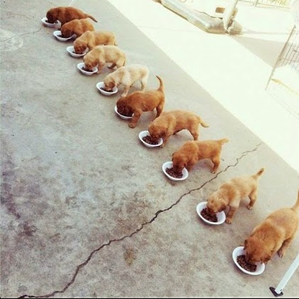
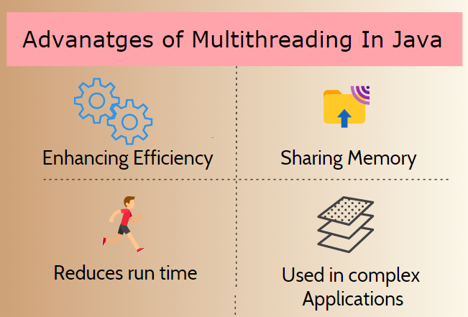
Multi-threading

Slide 11

High performance

Slide 12
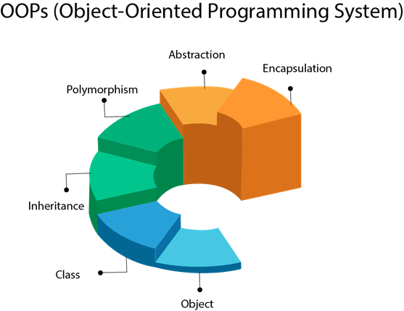

Slide 13
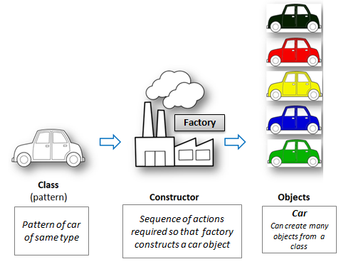

Slide 14
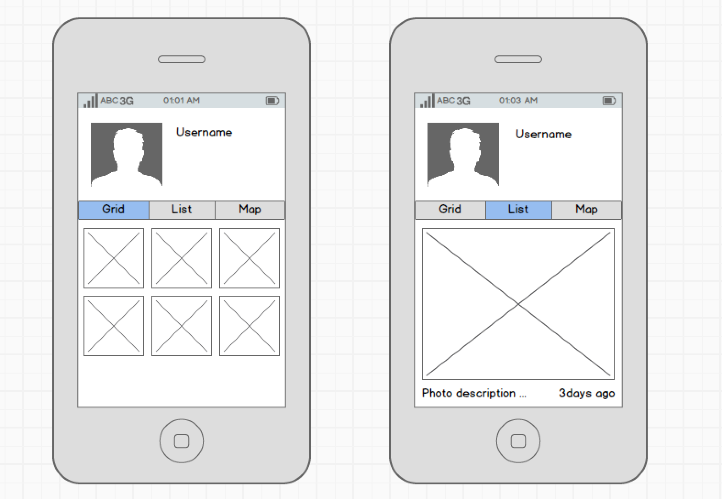
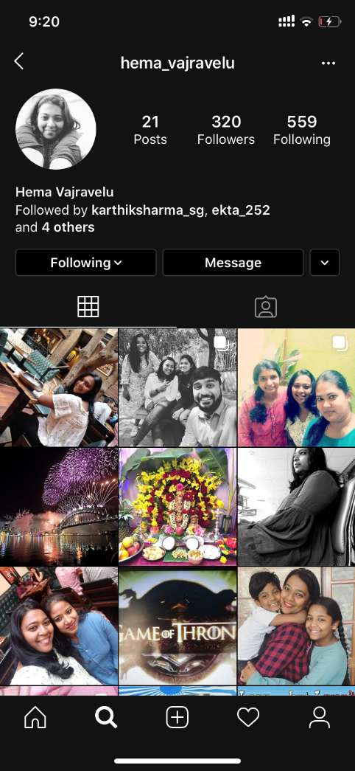
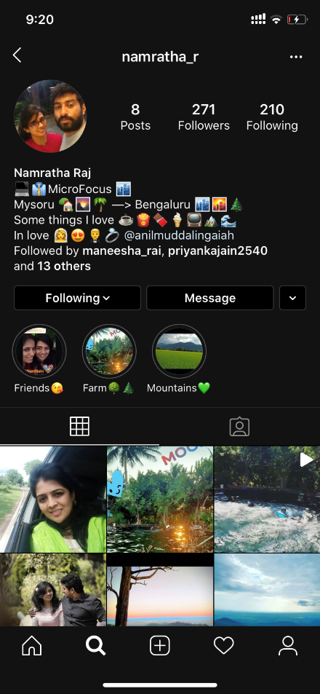
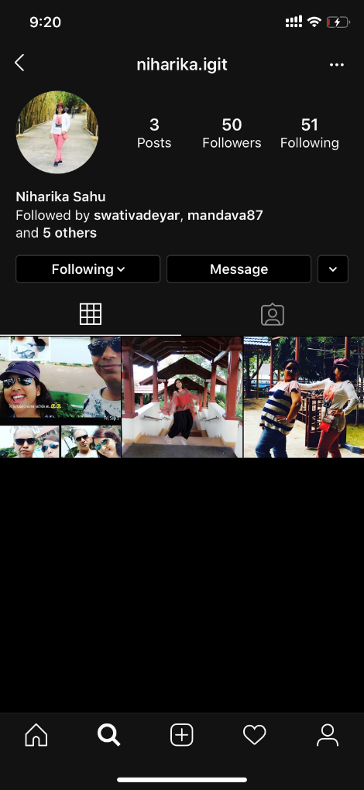
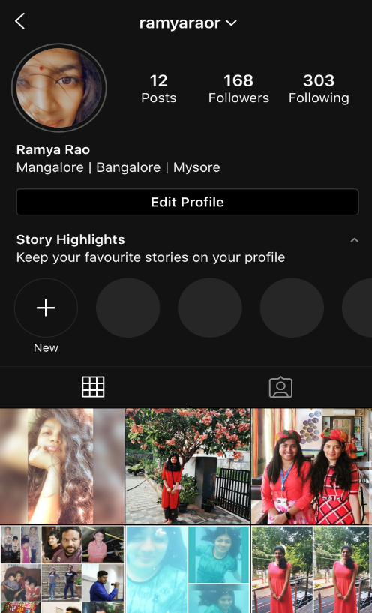
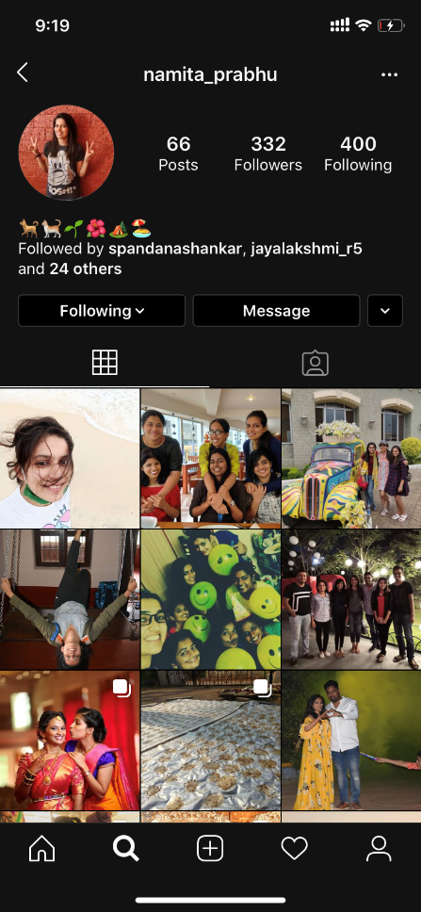
Class prototype

Slide 15
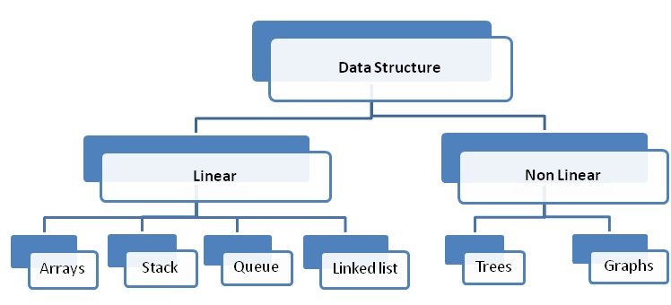

Slide 16
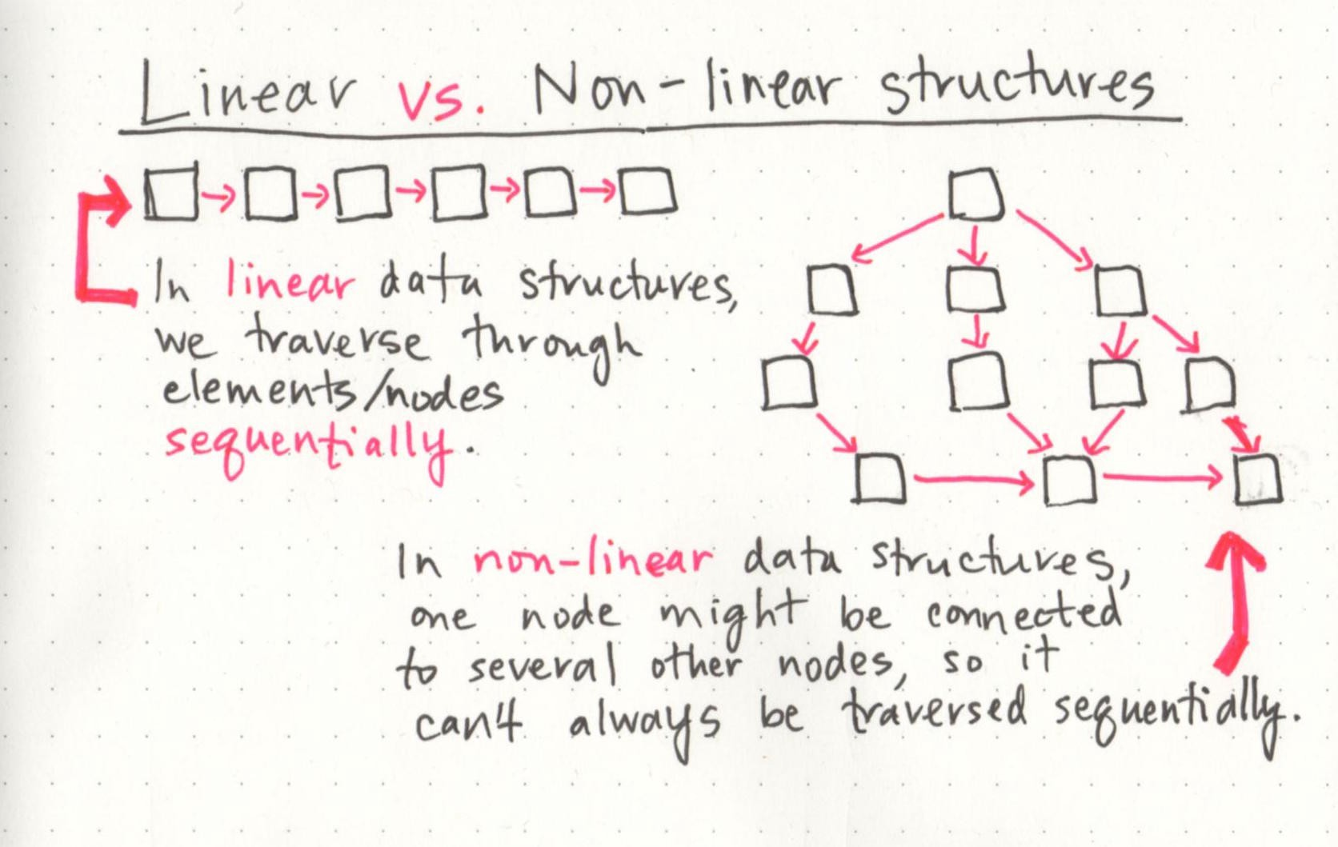

Slide 17
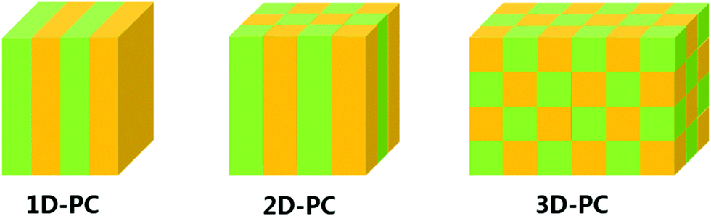
Arrays 1D and 2D

Slide 18
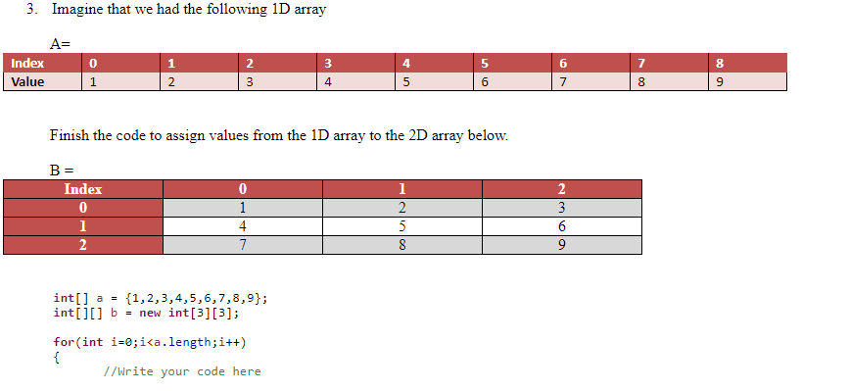
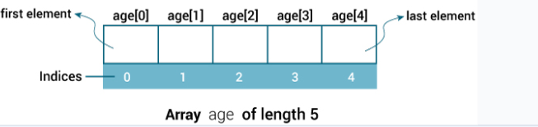

Slide 19
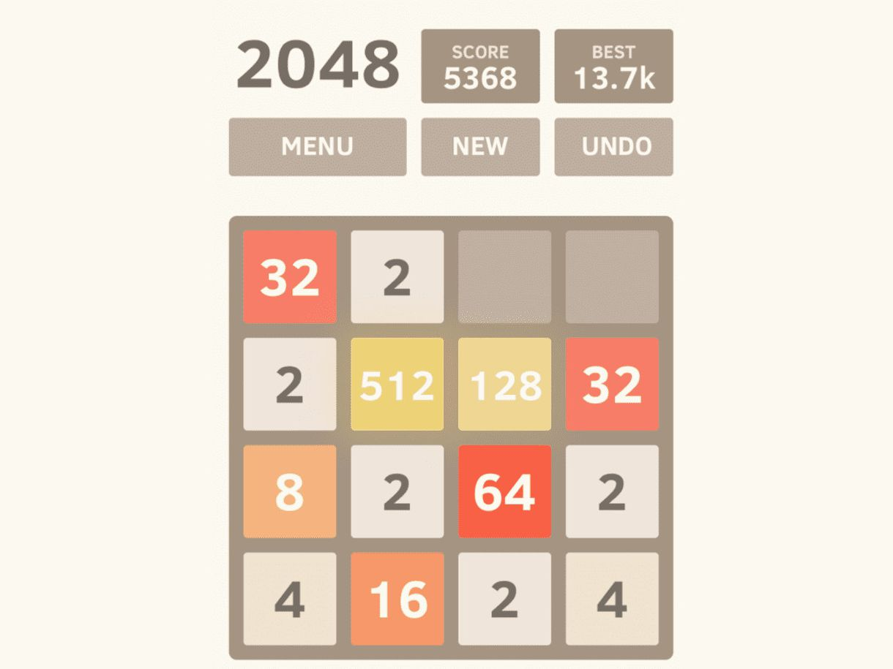

Slide 20
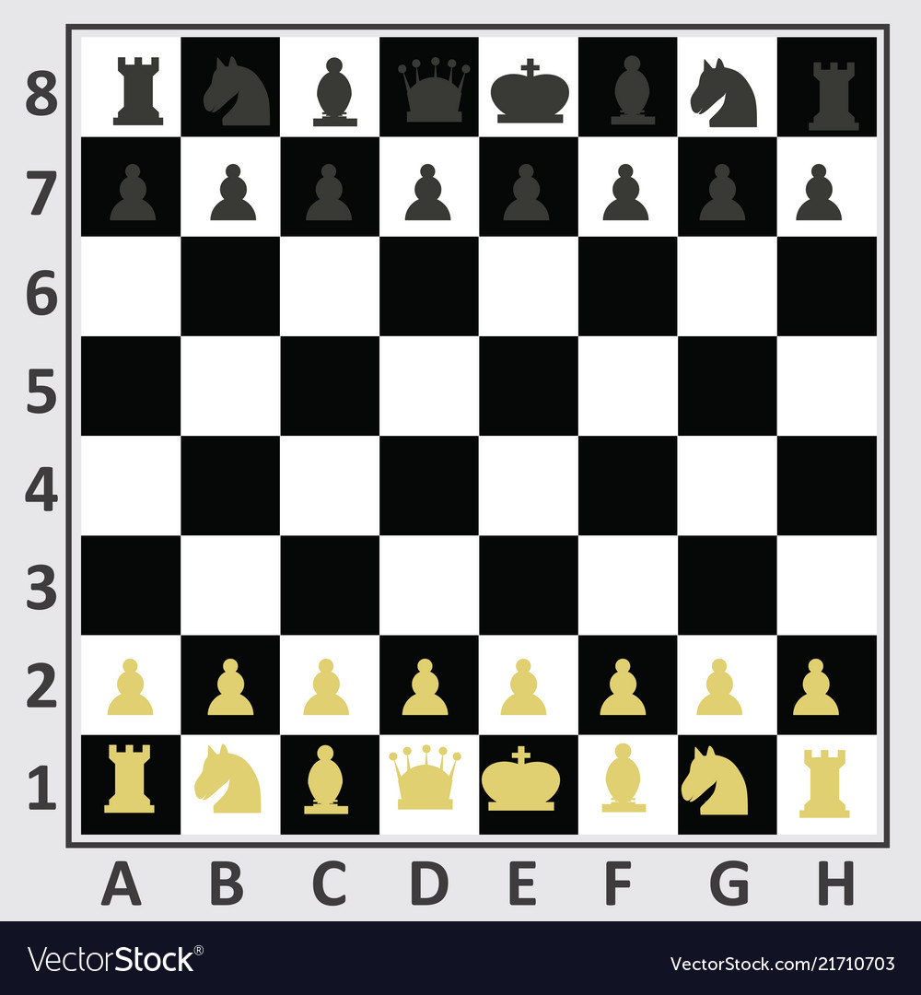

Slide 21
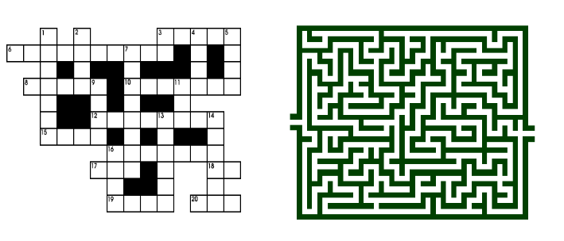
2D arrays are often used to represent tables, images, and game boards. Checkers, chess, tic-tac-toe, crosswords and mazes are examples of games that could be implemented using a 2D array.

Slide 22
What's next?
Accessing and manipulating arrays (1D & 2D) ( Write Programs )
Collections ( Write Programs )
Learn about built in methods - part1 ( Write Programs )
Handling Strings ( Write Programs )
End of the session : Build a medium difficulty program using all of the above learnt concepts
Solve a hacker-rank Program.
(1 hour session)?

Slide 23


